Slide 1
gRPC, REST, Protobuf, JSON

Slide 2
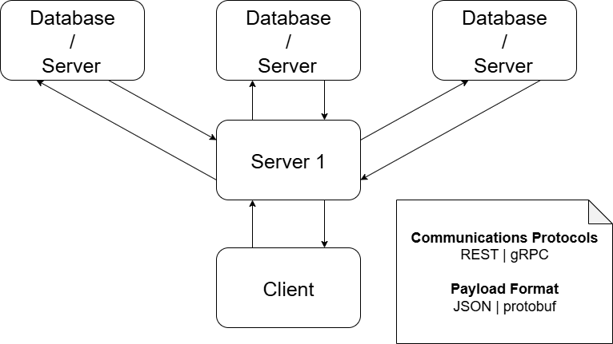
General architecture (Testing based on)

Slide 3
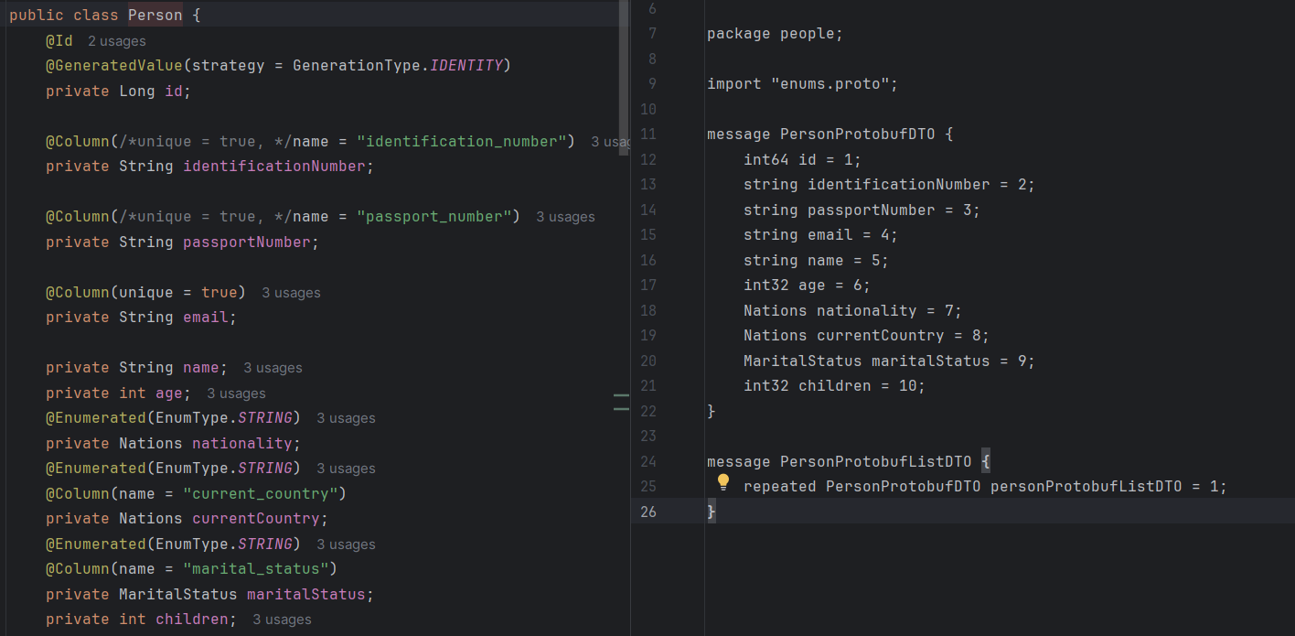
Entity / Payload [Person]
Notes:
Json protobuf, maybe due to bytes not converted, conversion not done
Grpc inconsistent not always faster?
Rest JSON still for single instances request/responses
Rest protobuf likely protocurl is not optimized

Slide 4
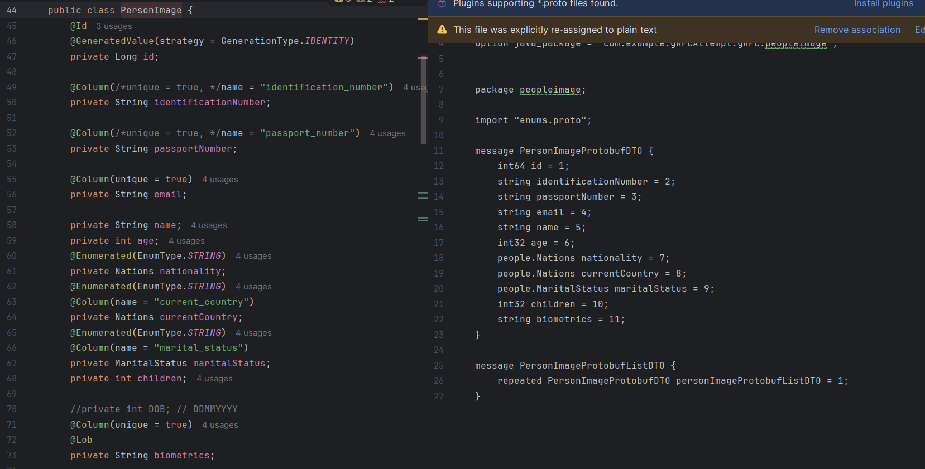
Entity / Payload [PersonImageString]
Notes:
Json protobuf, maybe due to bytes not converted, conversion not done
Grpc inconsistent not always faster?
Rest JSON still for single instances request/responses
Rest protobuf likely protocurl is not optimized

Slide 5
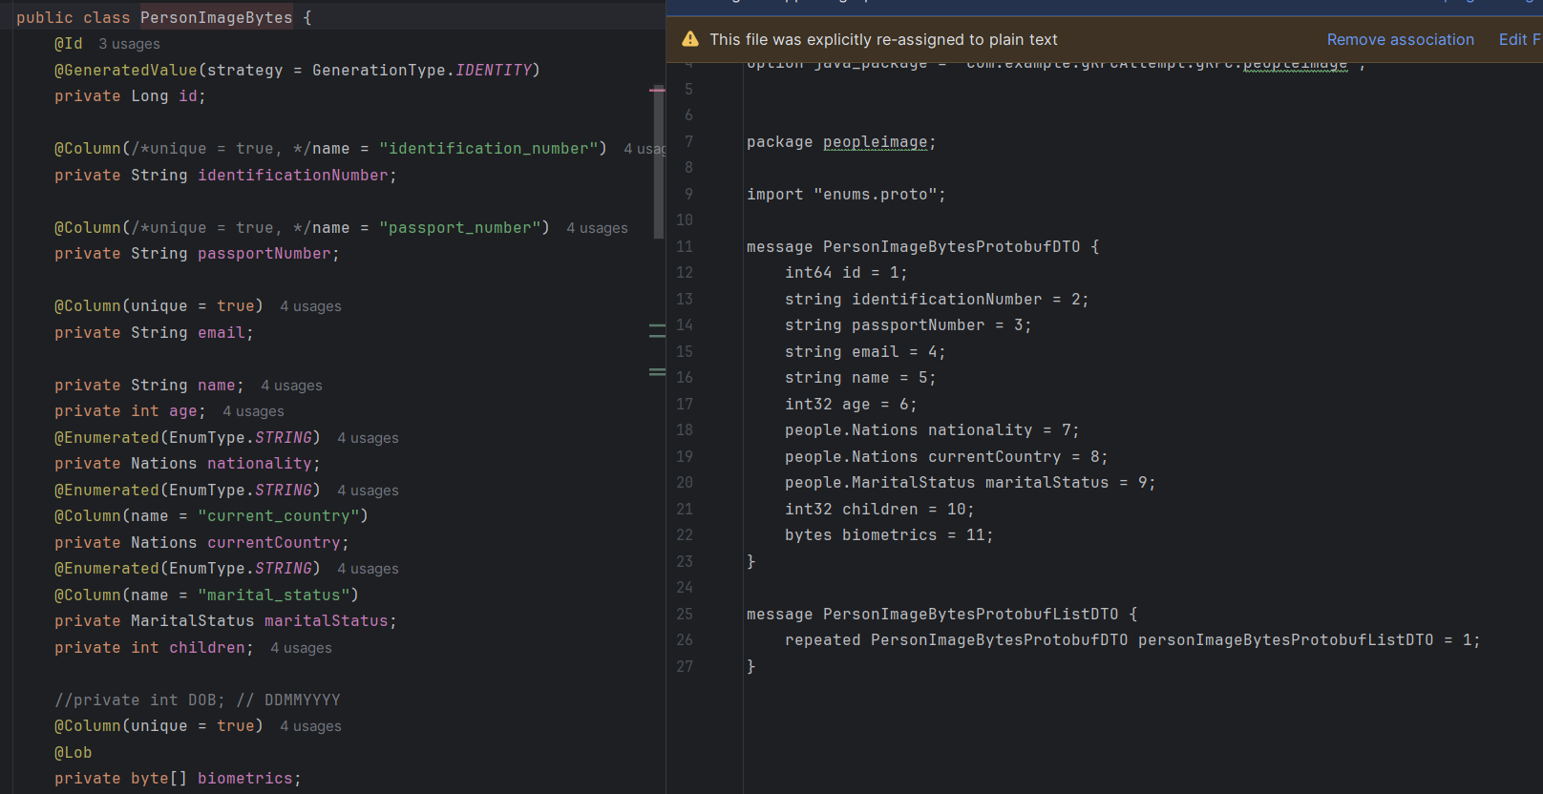
Entity / Payload [PersonImageBytes]
Notes:
Json protobuf, maybe due to bytes not converted, conversion not done
Grpc inconsistent not always faster?
Rest JSON still for single instances request/responses
Rest protobuf likely protocurl is not optimized

Slide 6
Client - Server
Note: gRPC is instanced for every call here like a REST call
Reflection for gRPC not presented in the slides

Slide 7
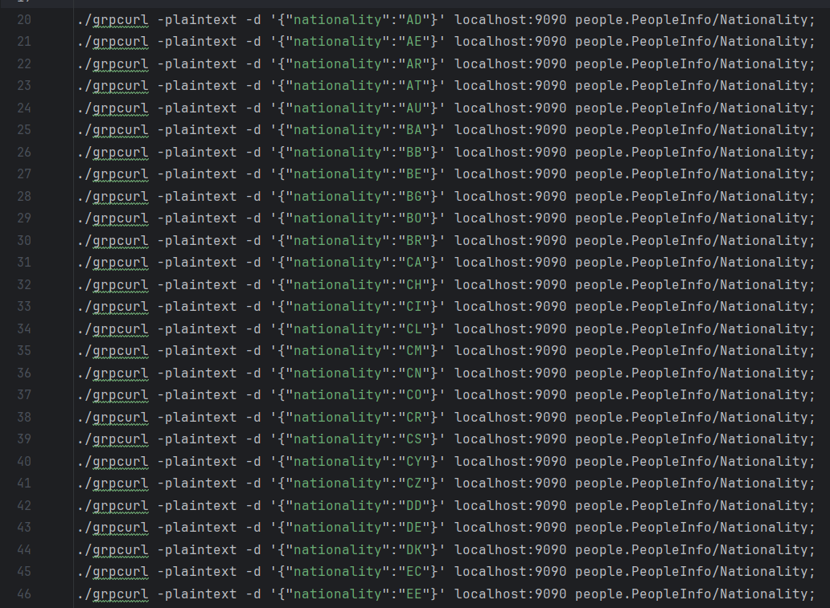
Test Case API Calls
Note: 97 Nations, 198 calls in total
Notes:
Json protobuf, maybe due to bytes not converted, conversion not done
Grpc inconsistent not always faster?
Rest JSON still for single instances request/responses
Rest protobuf likely protocurl is not optimized

Slide 8
Person payload
gRPC (gRPCurl) | REST (cURL) | REST (protoCURL) | REST (cURL) | REST (cURL)
REQUEST: protobuf RESPONSE: protobuf | REQUEST: JSON RESPONSE: protobuf | REQUEST: protobuf RESPONSE: protobuf | REQUEST: String/JSON RESPONSE: JSON | REQUEST: JSON RESPONSE: JSON
real 0m20.956s user 0m0.105s sys 0m0.749s | real 0m13.810s * user 0m0.166s sys 0m0.805s | real 0m38.767s user 0m0.121s sys 0m0.791s | real 0m22.641s user 0m0.241s sys 0m2.065s | real 0m21.812s user 0m0.166s sys 0m1.482s
*: Received protobuf is not converted into readable format, remains in protobuf binary/bytes
Notes:
Json protobuf, maybe due to bytes not converted, conversion not done
Grpc inconsistent not always faster?
Rest JSON still for single instances request/responses
Rest protobuf likely protocurl is not optimized

Slide 9
PersonImage(String) payload
gRPC (gRPCurl) | REST (cURL) | REST (protoCURL) | REST (cURL)
REQUEST: protobuf RESPONSE: protobuf | REQUEST: JSON RESPONSE: protobuf | REQUEST: protobuf RESPONSE: protobuf | REQUEST: JSON RESPONSE: JSON
real 0m22.919s user 0m0.120s sys 0m0.824s | real 0m17.600s * user 0m0.107s sys 0m0.488s | real 0m43.198s user 0m0.121s sys 0m0.928s | real 0m17.226s user 0m0.105s sys 0m0.947s
*: Received protobuf is not converted into readable format, remains in protobuf binary/bytes

Slide 10
PersonImage(Bytes) payload
PI Repository
PIB Repository
gRPC (gRPCurl) | REST (cURL) | REST (protoCURL)
REQUEST: protobuf RESPONSE: protobuf | REQUEST: JSON RESPONSE: protobuf | REQUEST: protobuf RESPONSE: protobuf
real 0m23.949s user 0m0.210s sys 0m0.948s | real 0m16.642s * user 0m0.135s sys 0m0.790s | real 0m38.019s user 0m0.229s sys 0m0.684s
gRPC (gRPCurl) | REST (cURL) | REST (protoCURL)
REQUEST: protobuf RESPONSE: protobuf | REQUEST: JSON RESPONSE: protobuf | REQUEST: protobuf RESPONSE: protobuf
real 0m23.180s user 0m0.075s sys 0m1.085s | real 0m16.290s * user 0m0.090s sys 0m0.596s | real 0m37.316s user 0m0.288s sys 0m0.902s
*: Received protobuf is not converted into readable format, remains in protobuf binary/bytes
Notes:
Protobuf binary bytes not converted

Slide 11
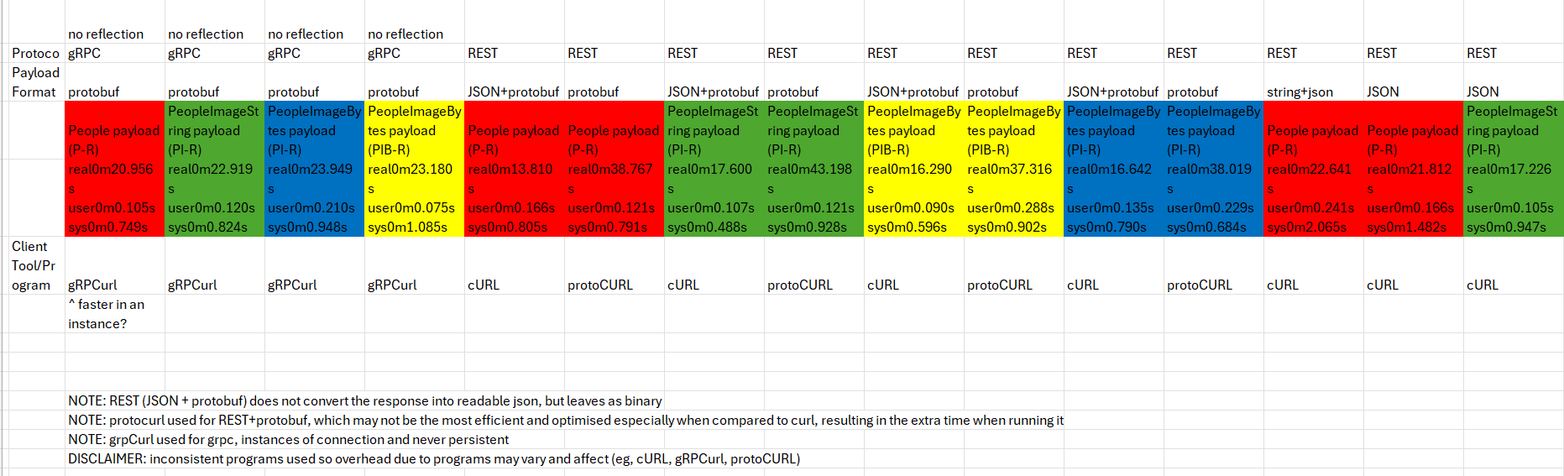
Overall View

Slide 12
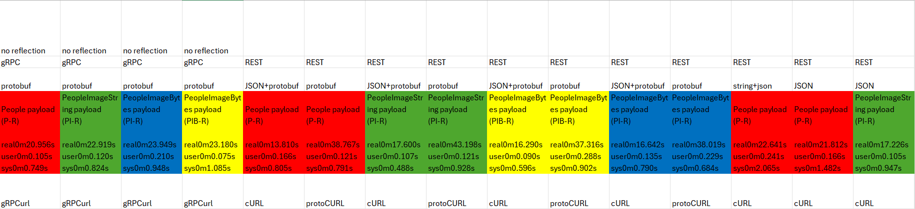
Overall View

Slide 13
Server - Server
Note: gRPC is done over a persistent connection for every call
UN-like a REST call

Slide 14
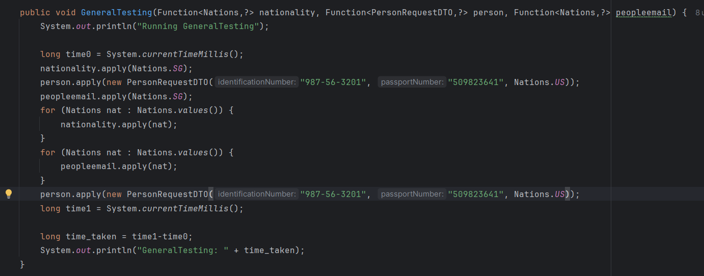
Test Case API Calls
Note: 97 Nations, 198 calls in total
Notes:
Json protobuf, maybe due to bytes not converted, conversion not done
Grpc inconsistent not always faster?
Rest JSON still for single instances request/responses
Rest protobuf likely protocurl is not optimized

Slide 15
Person payload
gRPC | REST | REST | REST | REST
REQUEST: protobuf RESPONSE: protobuf | REQUEST: JSON RESPONSE: protobuf | REQUEST: protobuf RESPONSE: protobuf | REQUEST: String/JSON RESPONSE: JSON | REQUEST: JSON RESPONSE: JSON
150.94 | 251.92 | 244.4 | 294.18 | 265.82
Average over 50 iterations, Timings are in ms(milliseconds)
Notes:
Json protobuf, maybe due to bytes not converted, conversion not done
Grpc inconsistent not always faster?
Rest JSON still for single instances request/responses
Rest protobuf likely protocurl is not optimized

Slide 16
PersonImage(String) payload
gRPC | REST | REST | REST
REQUEST: protobuf RESPONSE: protobuf | REQUEST: JSON RESPONSE: protobuf | REQUEST: protobuf RESPONSE: protobuf | REQUEST: JSON RESPONSE: JSON
1257.3 | 2243.4 | 2248.42 | 2056.3
Average over 50 iterations, Timings are in ms(milliseconds)

Slide 17
PersonImage(Bytes) payload
PI Repository
PIB Repository
gRPC | REST | REST
REQUEST: protobuf RESPONSE: protobuf | REQUEST: JSON RESPONSE: protobuf | REQUEST: protobuf RESPONSE: protobuf
1159.84 | 1575.28 | 1568.84
gRPC | REST | REST
REQUEST: protobuf RESPONSE: protobuf | REQUEST: JSON RESPONSE: protobuf | REQUEST: protobuf RESPONSE: protobuf
469.02 | 872.36 | 869.26
Average over 50 iterations, Timings are in ms(milliseconds)

Slide 18
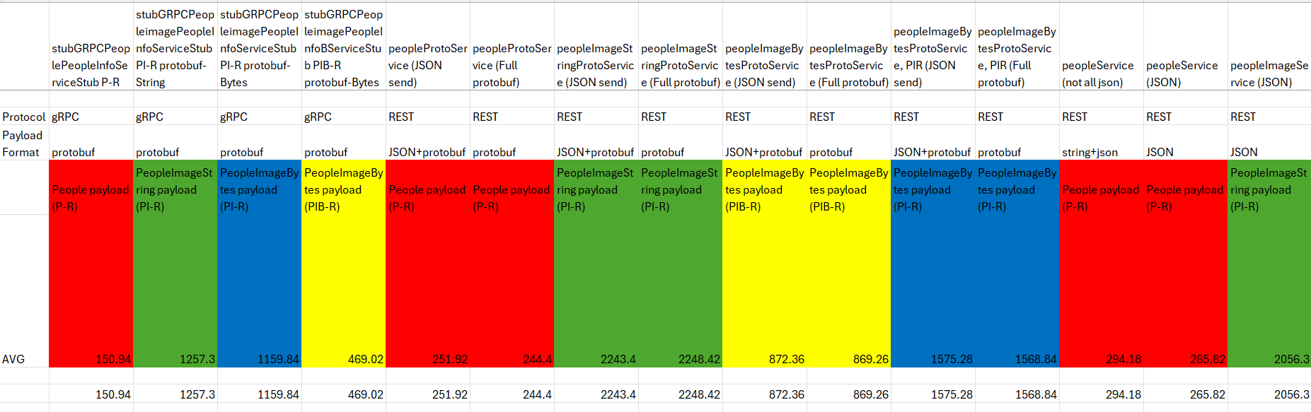
Overall View

Slide 19
Overall View

